Slide 1
Terrestrial
Gamma-ray Flashes

Slide 2
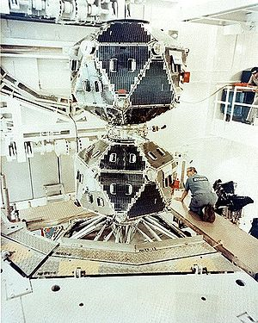
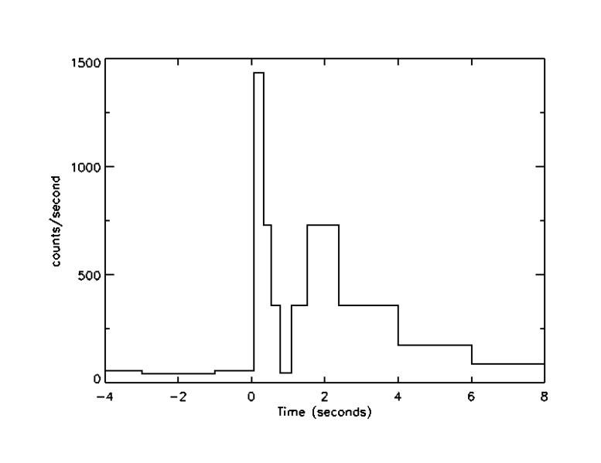
Gamma Ray Astronomy Beginning
started as a small budget research program in 1959
monitoring compliance with the 1963 Partial Test Ban Treaty by the Soviet Union, and other nuclear-capable states
12 external X-ray detectors and 18 internal neutron and gamma-ray detectors
on July 2, 1967, at 14:19 UTC, the Vela 4 and Vela 3 satellites detected a flash of gamma radiation…

Slide 3
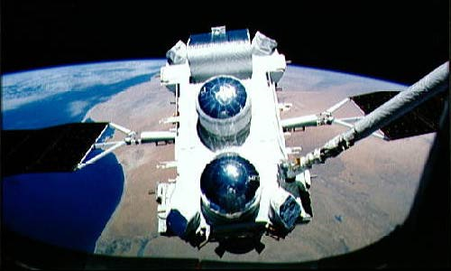
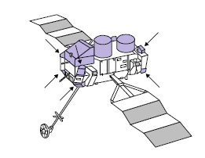
Compton Gamma Ray Observatory (CGRO)
Burst And Transient Source Experiment (BATSE, 1991-2000):
eight scintillator panels
each with effective area 2000 cm²
energies from 25 keV to above 1MeV mounted on the corners of CGRO (spatial
information)
Sometimes bursts of radiation were observed
only by detectors facing the Earth.
They were much shorter than the typical gamma-ray burst

Slide 4
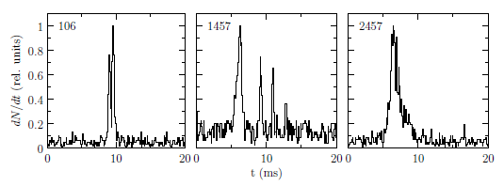
Compton Gamma Ray Observatory (CGRO)
G. J. Fishman et al., Science 264, 1313 (1994)
The y axis represents count rate of 25-1000 keV photons
BATSE data shows TGFs as short bursts of up to 1000 photons with energies ranging from 25 keV up to above 1MeV.
About 70 events were detected during the entire mission

Slide 5
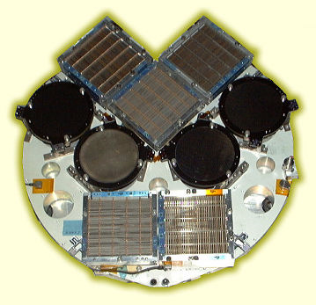
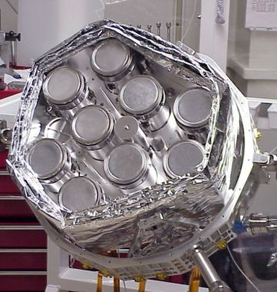
Ramaty High Energy Solar Spectroscopic Imager
Small Explorer (SMEX)
No shielding (good for TGF, bad for solar flares)
Each photon is counted – time and energy
TGFs recognized through time characteristic – duration less than 10 ms is much shorter than for typical GRB
RHESSI does not give spatial information concernig TGFs

Slide 6
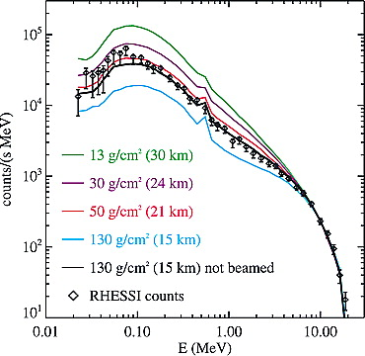
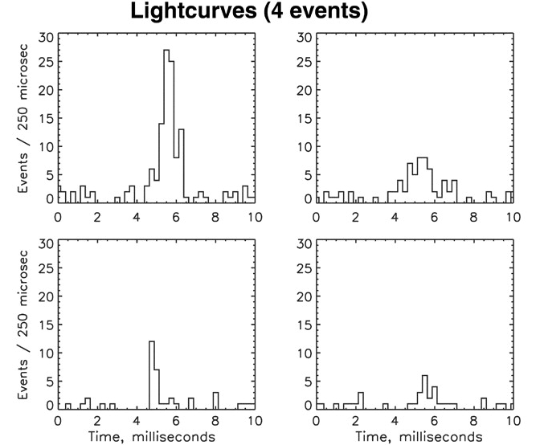
Ramaty High Energy Solar Spectroscopic Imager
Worse sensitivity (effective area 200 cm²)
Better time resolution
Over 800 events (years 2002 - 2008)
Accumulated spectrum of 85 RHESSI TGFs, with theoretical relativistic-runaway spectra
The only difference between the models is the altitude of the average TGF
Smith et al. Science 307 no. 5712, 1085 (2005)

Slide 7
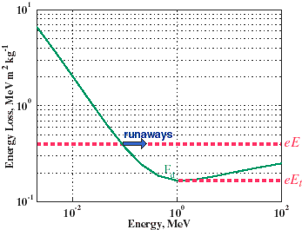
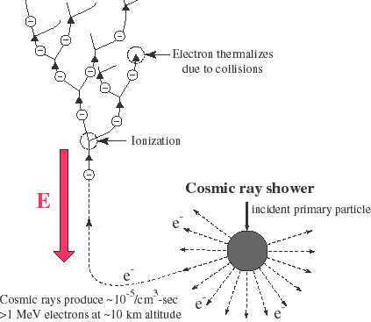
Runaway Breakdown Mechanism
Gurevich et al., Phys. Letters A 165, 463 (1992)
Energy loss due to collisions decrease with
increasing energy
Electrons with sufficient initial energy can be
accelerated by electric fields
Accelerated electrons collide with atmospheric
molecules, ionize them and produce more
relativistic electrons.
Most newly produced electrons thermalize
because of collisions (gamma ray emission),
but some accelerate and contribute to the avalanche
Spark: cosmic ray particle
http://www-star.stanford.edu/~vlf/runaway/

Slide 8
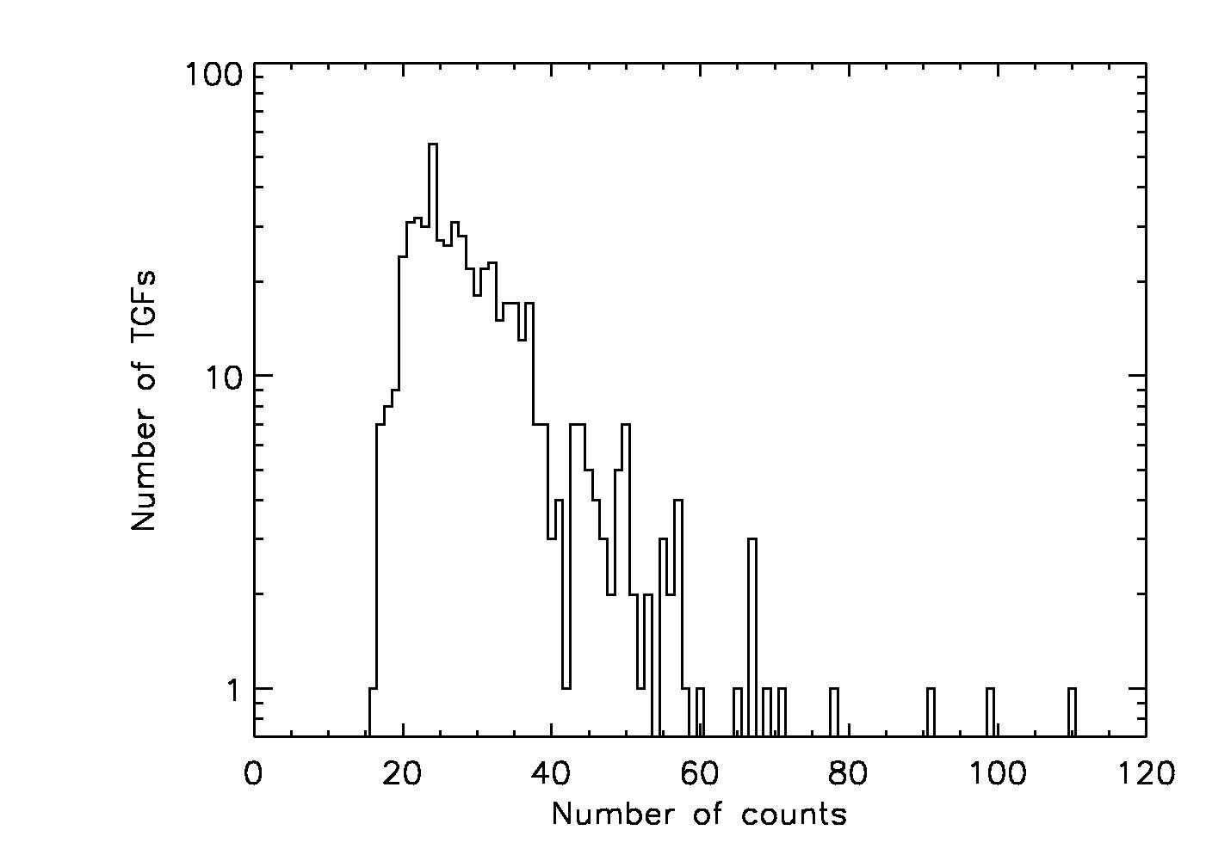
RHESSI TGFs and Lightnins
RHESSI TGFs for which lightning
data is available show
coincident lightning activity
within several milliseconds
for 76% of TGFs
RHESSI TGF Positions
Visible Lightning Positions
?
Are the RHESSI
events the tip
of the iceberg?
Smith et al. Science 307 no. 5712, 1085 (2005)

Slide 9
Ramaty High Energy Solar Spectroscopic Imager
http://svs.gsfc.nasa.gov/

Slide 10
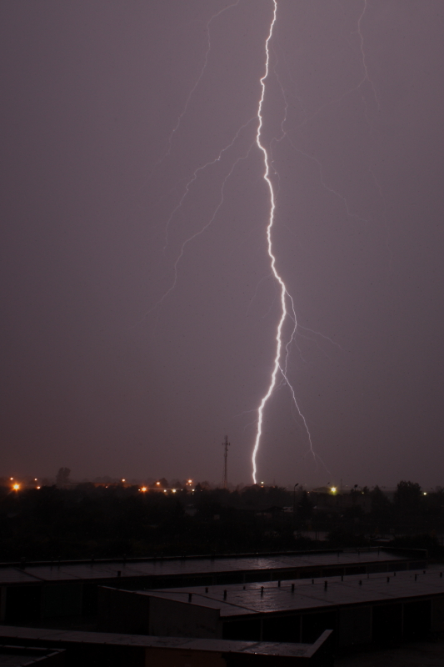
What do You know about lightnings?
Blinding oh, Yeah
Hit the ground are You sure?
Short duration well, but...
Relatively simple shape definately not
Additional effects: thunder not only

Slide 11
What do You know about lightnings?

Slide 12
What do You know about lightnings?

Slide 13
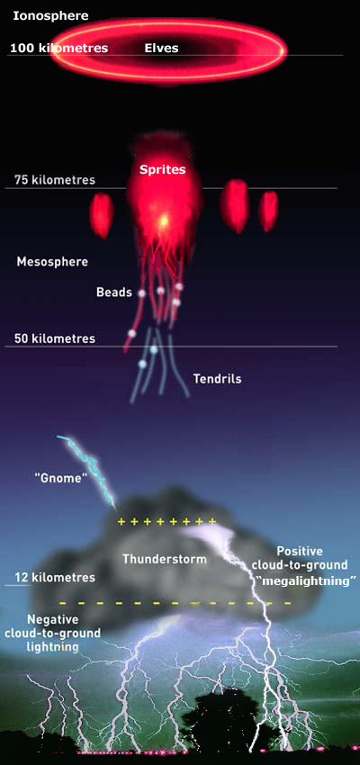
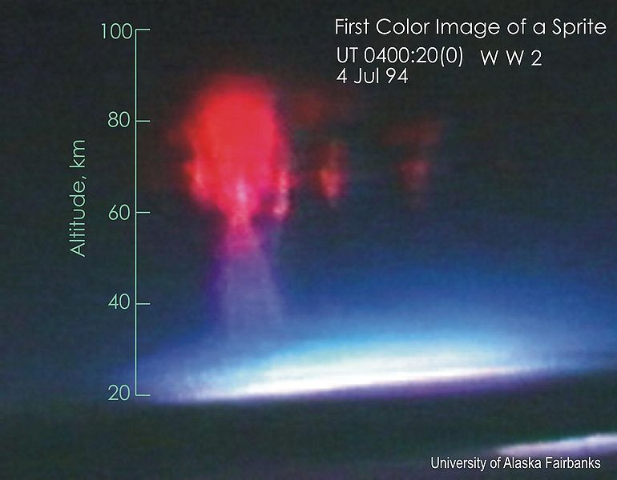
Sprites, Elves, Gnomes...
first photographed on July 6, 1989
observed above thunderstorms
extremely short
observed few miliseconds after lightning

Slide 14
Sprites

Slide 15
Sprites

Slide 16
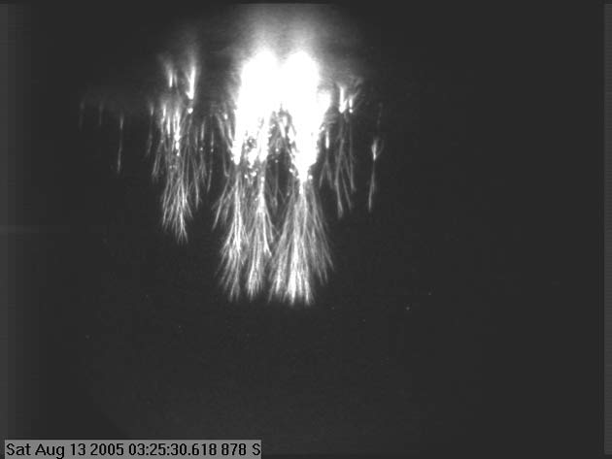
Sprites
Consistent with running
breakdown mechanism
The source of TGFs?

Slide 17
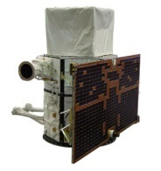
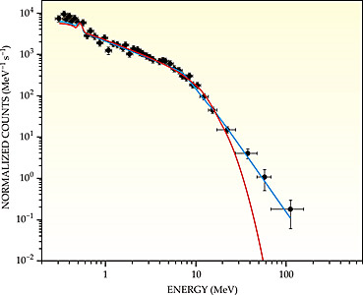
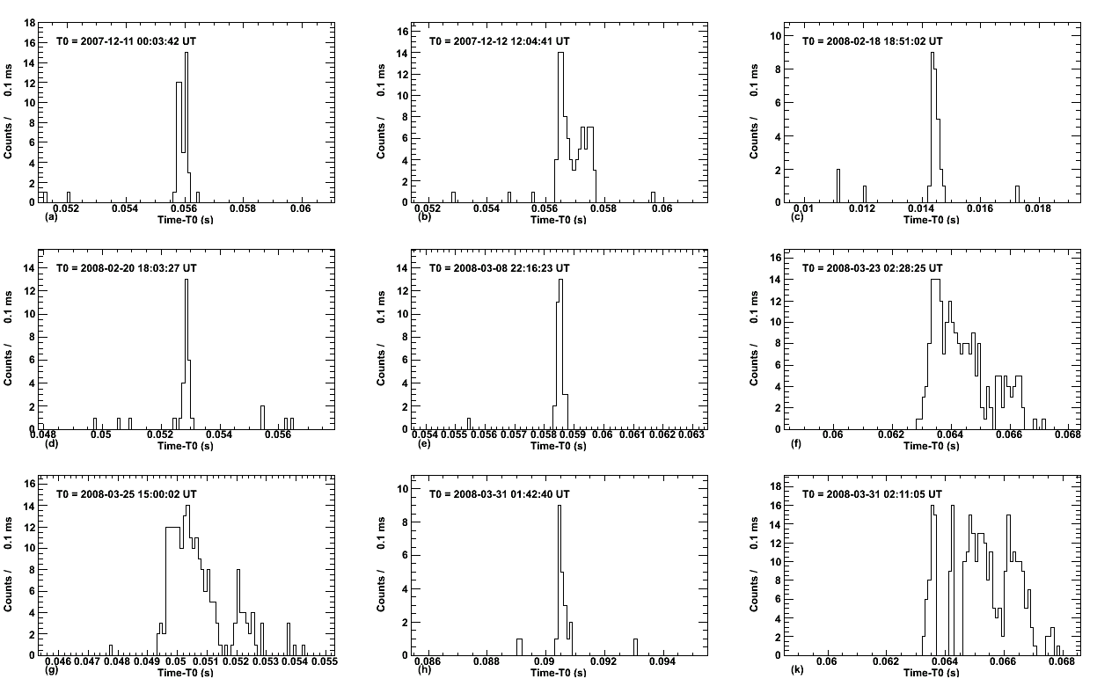
New Instrumentation
AGILE (Astro‐rivelatore Gamma a Immagini LEggero)
combines gamma-ray imager (30 MeV- 30 GeV) with a hard X-ray imager (18-60 keV) with large FOVs (1-2.5 sr) and optimal angular resolution
detects ~10 TGFs/month
AGILE and RHESSI TGF samples
are consistent concerning
longitude, local time
distribution and spectral shape
cumulative spectrum with
significant detection
above 40 MeV

Slide 18
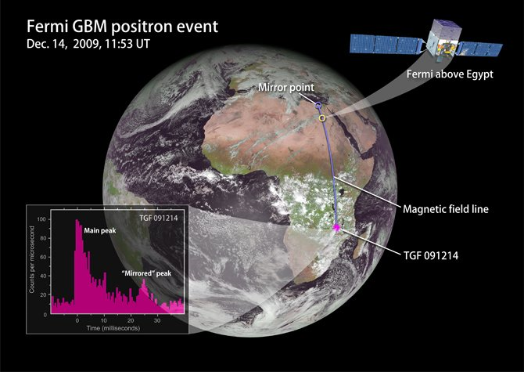
New Instrumentation
Fermi Gamma Ray Space Telescope and new discovery

Slide 19
Conclusions
We live in interesting times…

